Slide 1
FAP - applications in research and education
Zoltan Geler, Vladimir Kurbalija, Miloš Radovanović Mirjana Ivanović
University of Novi Sad, Serbia

Slide 2
Contents
Time series
Framework for Analysis and Prediction
Applications in research
Applications in education
Publications

Slide 3
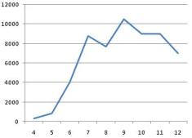
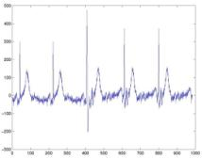
Time Series - Definition -
Series of numerical data points in successive order, usually with uniform intervals between them.
Almost every aspect of human activity:
Social, economic and natural phenomena,
Medical observations,
Results of scientific and engineering experiments.

Slide 4
Time Series - Distance Measures -
One of the most important issues of time-series data mining tasks is the choice of the distance measure:
Euclidean distance,
Dynamic Time Warping (DTW),
Longest Common Subsequence (LCS),
Edit Distance with Real Penalty (ERP),
Edit Distance on Real sequence (EDR).

Slide 5
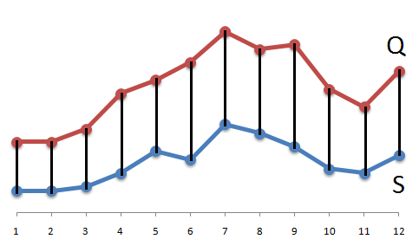
Time Series - Euclidean Distance -
Linear aligning of points
Advantages:
Easy to implement,
Fast to compute,
Distance metric.
Shortcomings:
Sensitive to distortions and shifting along the time axis.

Slide 6
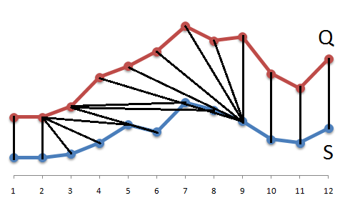
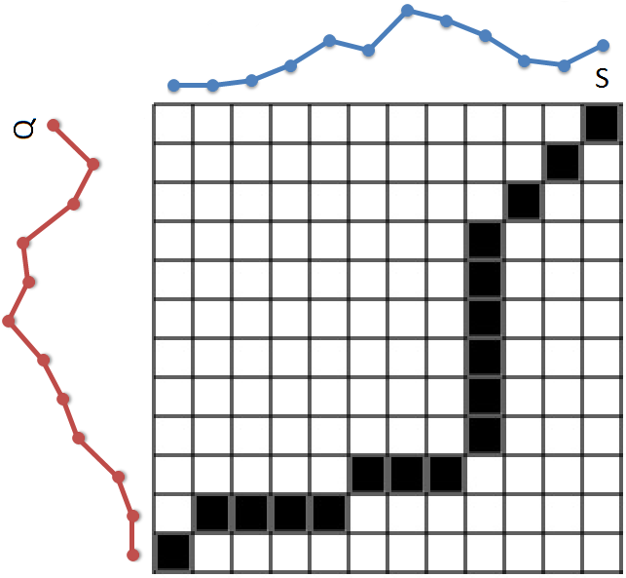
Time Series - Elastic Measures -
Elastic distance measures:
DTW, LCS,...
Non-linear aligning of points
Dynamic programming:
We need to compare each point of one time series with each point of the other one.

Slide 7
Contents
Time series
Framework for Analysis and Prediction
Applications in research
Applications in education
Publications

Slide 8
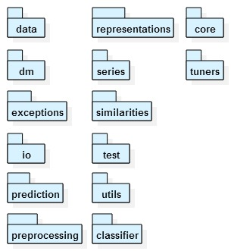
Framework for Analysis and Prediction - Basic Features -
Free, extensible open-source software package. [Kurbalija et al., 2010]
Java
Implements the main techniques and methods needed for the analysis of time series and for temporal data mining.
http://perun.pmf.uns.ac.rs/fap/

Slide 9
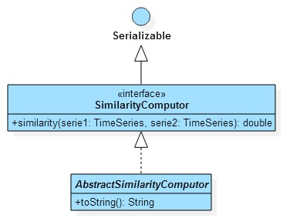
Framework for Analysis and Prediction - Distance Measures -
Several distance measures are implemented, including:
Euclidean distance,
DTW,
LCS,
ERP,
EDR,
Spline,
TWED.

Slide 10
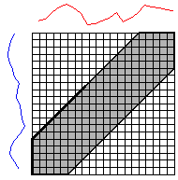
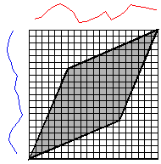
Framework for Analysis and Prediction - Global Constraints -
Constraining the warping path:
Speed up the computation
Prevent pathological aligning of points
Sakoe-Chiba
Itakura

Slide 11
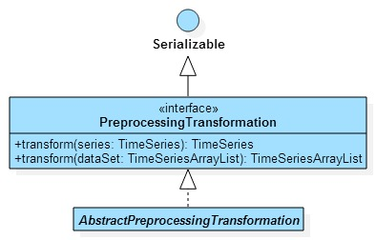
Framework for Analysis and Prediction - Preprocessing Algorithms -
Prepare and clean the data before use
Scaling,
Shifting,
Z-score normalization,
Min-max normalization,
Decimal scaling.

Slide 12
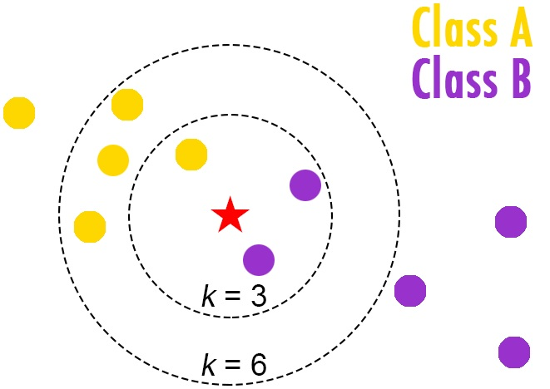
Framework for Analysis and Prediction - Classifiers -
Nearest-neighbor (1NN),
k-nearest neighbor (kNN),
Distance-weighted k-nearest neighbor.
Classifier evaluation methods:
Holdout,
Cross-Validation,
Leave-One-Out.

Slide 13
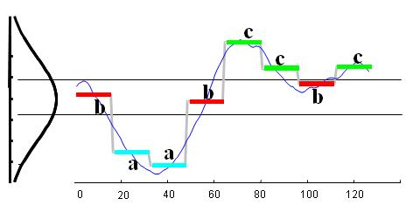
Framework for Analysis and Prediction - Representations -
Storing requires large amount of space
Not interested in exact values
Simplified representations of time series:
Piecewise Linear Approximation (PLA),
Piecewise Aggregate Approximation (PAA),
Adaptive Piecewise Constant Approximation (APCA),
Symbolic Aggregate Approximation (SAX),
Spline.

Slide 14
Contents
Time series
Framework for Analysis and Prediction
Applications in research
Applications in education
Publications

Slide 15
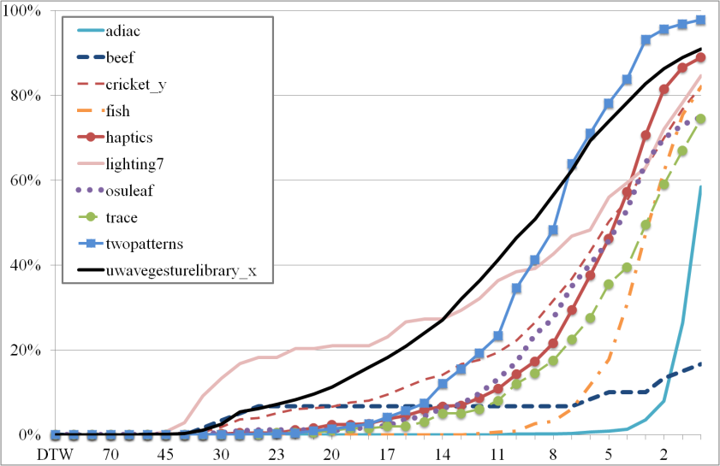
Applications in research - The influence of global constraints 1 -
The influence of the Sakoe-Chiba band on the 1NN classifier. [Kurbalija et al., 2011, 2014a]
The change of the 1NN graph with respect of the constraint size.
The constrained measures are qualitatively different than the unconstrained ones.
A
A
Sakoe-Chiba
B
C
B
C

Slide 16
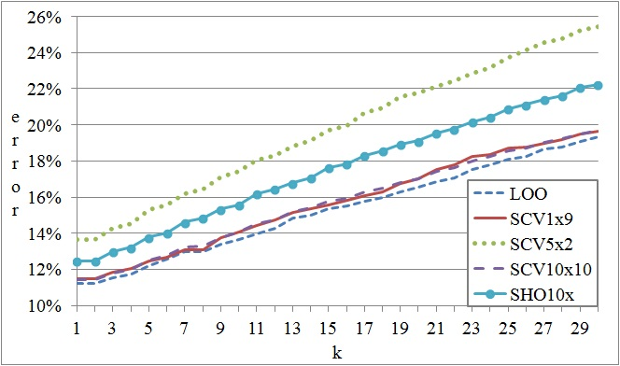
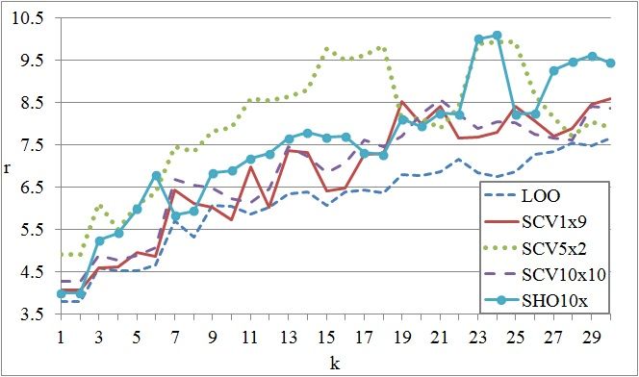
Applications in research - The influence of global constraints 2 -
The influence of the Sakoe-Chiba band on kNN. [Geler et al., 2014]
Minimal width of the warping window that maximizes the classification accuracy of the kNN classifier, and the average error rate.

Slide 17
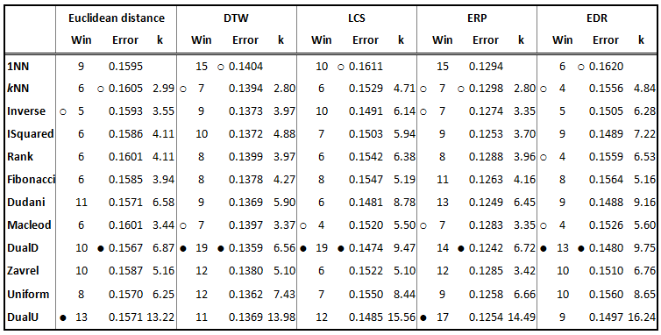
Applications in research - Comparison of weighting schemes -
Can the weighting schemes improve the classification accuracy?

Slide 18
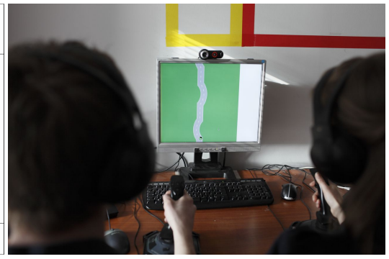
Applications in research - Psychological and medical domain -
Analyzing team behavior – in order to develop artificial agents that can substitute human participants. [Kurbalija et al., 2012, 2014b]
Finding the best distance measures for the task of detecting Tacrolimus-sensitive patients. [Kurbalija et al., 2014c]

Slide 19
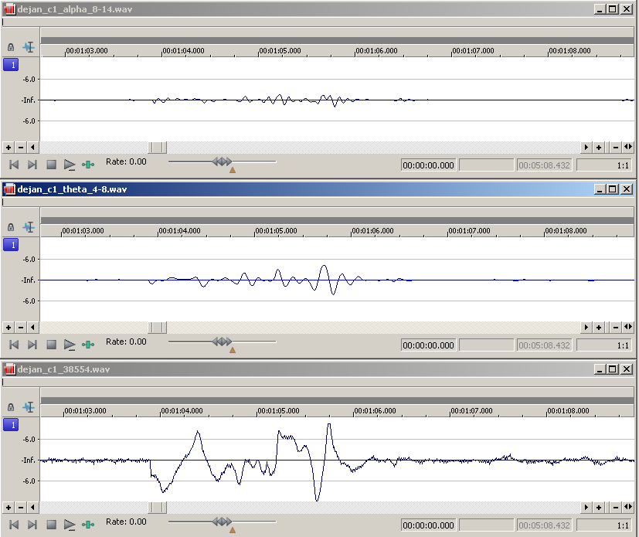
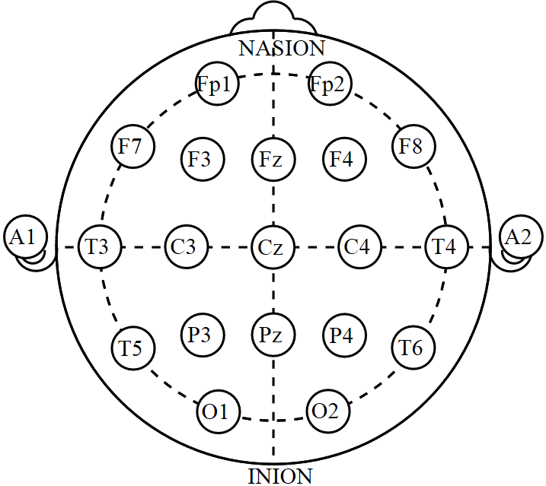
Applications in research - Emotion recognition -
Emotion recognition based on classification accuracies [Kurbalija et al., 2015]
Does language understanding have an impact on emotion perecption?

Slide 20
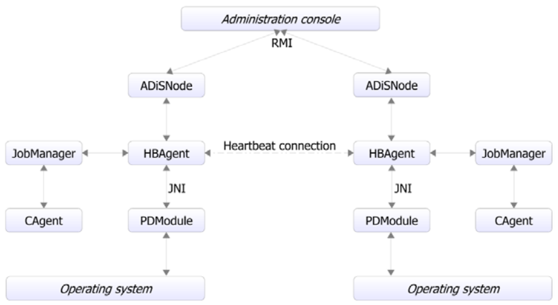
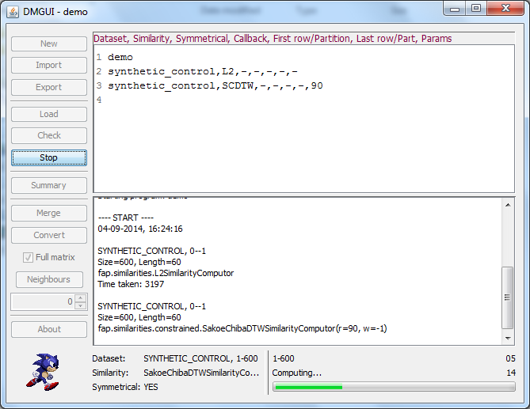
Applications in research - Agents -
DMGUI – Graphical User Interface for generating distance matrices
ADiS – Agent-based Distributed computing System [Mitrović et al., 2012, 2014]

Slide 21
Contents
Time series
Framework for Analysis and Prediction
Applications in research
Applications in education
Publications

Slide 22
Applications in education - Courses and Theses -
Master studies of Informatics, seminar papers:
Data mining,
Artificial Intelligence 2.
Bachelor’s and Master’s theses

Slide 23
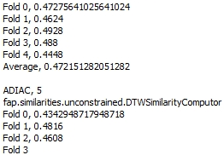
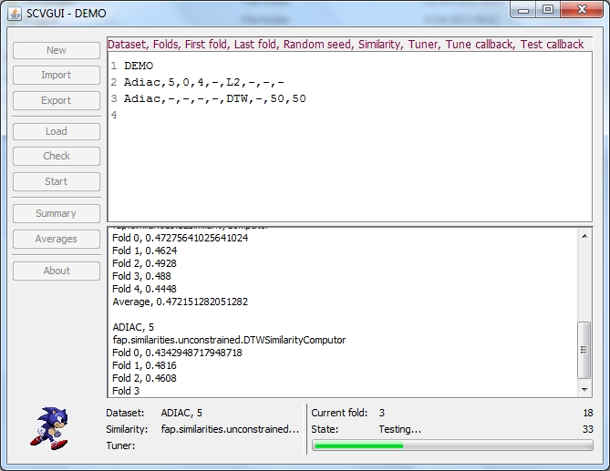
Applications in education - SCVGUI -
Stratified Cross-Validation GUI [Kurbalija et al., 2010]
Performs Cross-Validation experiments.
Originally developed to validate the correctness of the implementation of distance measures within FAP.

Slide 24
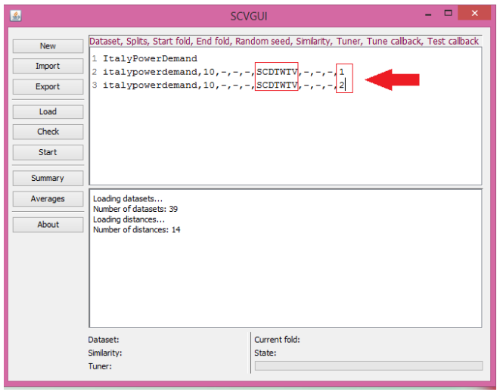
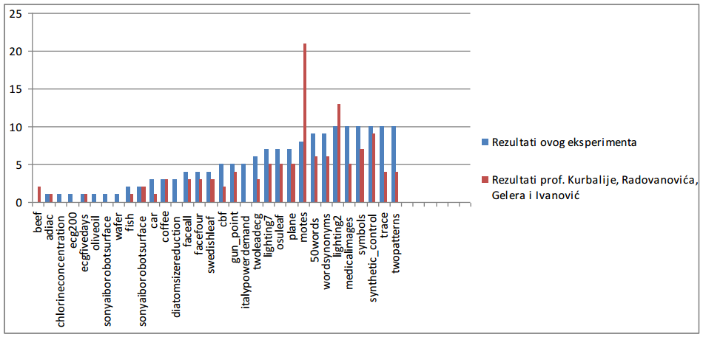
Applications in education - An extension of SCVGUI -
Course: Data mining
Ability to directly set the size of the Sakoe-Chiba band
The influence of the Sakoe-Chiba band on the 1NN classifier.

Slide 25
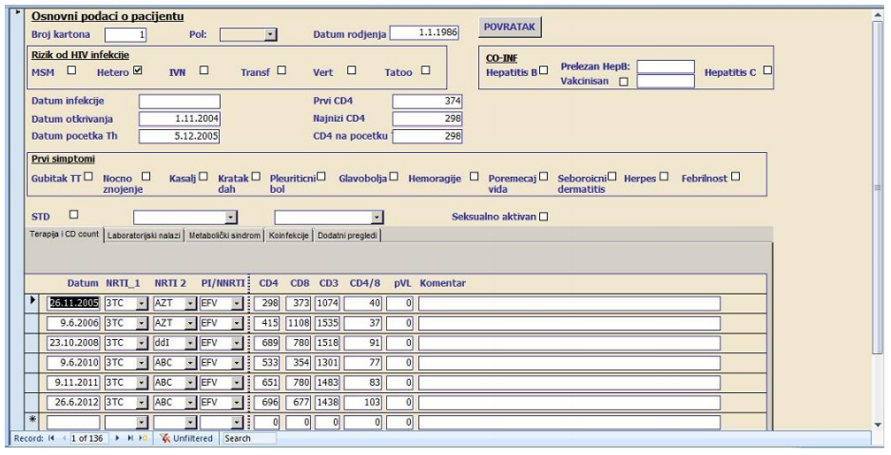
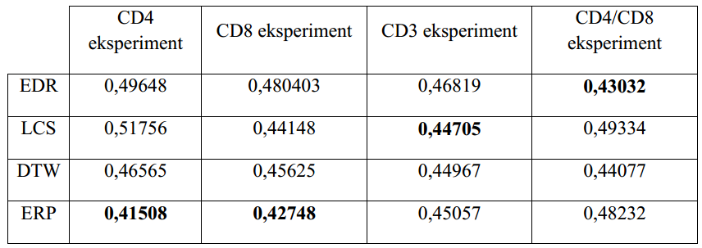
Applications in education - Medical domain -
Course: Data mining
Analysing medical records of patients with HIV infection using different distance measures.
Two types of therapies were applied on patients and four kinds of recovery indicators were analyzed.

Slide 26
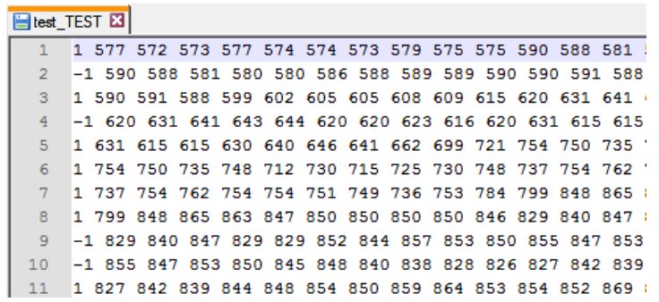
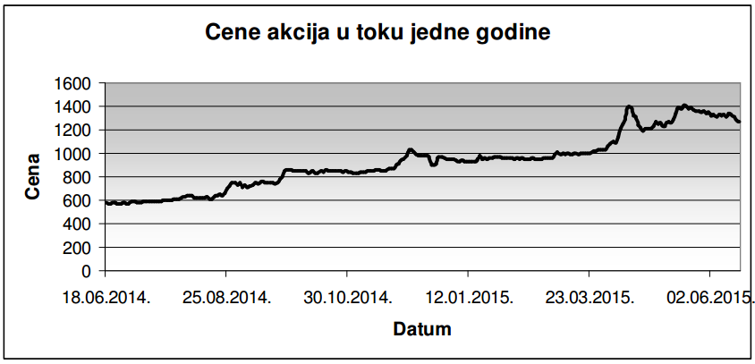
Applications in education - Financial domain -
Course: Artificial Intelligence 2
Using techniques of time series analysis in predicting the change of stock prices based on one-year history.

Slide 27
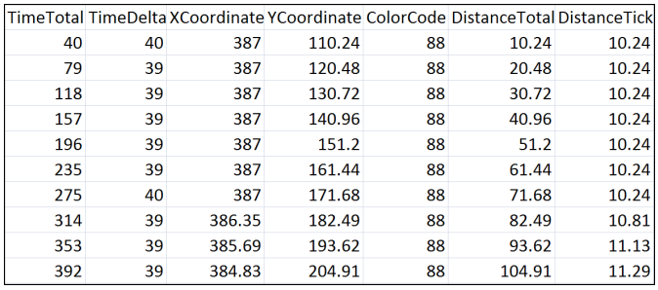
Applications in education - Psychological domain -
Master’s thesis
Analysing logfile data obtained from SAM (Socially Augmented Microworld) experiments using FAP in order to find the best distance measure.
Two participants navigate an object along a virtual track in a cooperative manner.
Focus on speed and accuracy

Slide 28
Contents
Time series
Framework for Analysis and Prediction
Applications in research
Applications in education
Publications

Slide 29
Publications - Part 1 -
Kurbalija, V., Ivanović, M. and Budimac, Z. 2009. Case-based curve behaviour prediction. Software: Practice and Experience. 39, 1 (2009), 81–103.
Kurbalija, V., Radovanović, M., Geler, Z. and Ivanović, M. 2010. A Framework for Time-Series Analysis. Artificial Intelligence: Methodology, Systems, and Applications SE - 5. D. Dicheva and D. Dochev, eds. Springer Berlin Heidelberg. 42–51.
Kurbalija, V., Radovanović, M., Geler, Z. and Ivanović, M. 2011. The Influence of Global Constraints on DTW and LCS Similarity Measures for Time-Series Databases. Third International Conference on Software, Services and Semantic Technologies S3T 2011 SE - 10. D. Dicheva, Z. Markov, and E. Stefanova, eds. Springer Berlin Heidelberg. 67–74.
Kurbalija, V., Radovanović, M., Geler, Z. and Ivanović, M. 2014a. The influence of global constraints on similarity measures for time-series databases. Knowledge-Based Systems. 56, (2014), 49–67.
Geler, Z., Kurbalija, V., Radovanović, M. and Ivanović, M. 2014. Impact of the Sakoe-Chiba Band on the DTW Time Series Distance Measure for kNN Classification. The 7th International Conference on Knowledge Science, Engineering and Management KSEM 2014 (Cham, 2014), 105–114.

Slide 30
Publications - Part 2 -
Kurbalija, V., von Bernstorff, C., Burkhard, H.-D., Nachtwei, J., Ivanović, M. and Fodor, L. 2012. Time-series Mining in a Psychological Domain. Proceedings of the Fifth Balkan Conference in Informatics (New York, NY, USA, 2012), 58–63.
Kurbalija, V., Ivanović, M., von Bernstorff, C., Nachtwei, J. and Burkhard, H.-D. 2014b. Matching Observed with Empirical Reality–What you see is what you get? Fundamenta Informaticae. 129, 1 (2014), 133–147.
Kurbalija, V., Radovanović, M., Ivanović, M., Schmidt, D., Trzebiatowski, G.L. von, Burkhard, H. and Hinrichs, C. 2014c. Time-Series Analysis in the Medical Domain: A Study of Tacrolimus Administration and Influence on Kidney Graft Function. Computers in Biology and Medicine. 50, (2014), 19–31.
Kurbalija, V., Ivanović, M., Radovanović, M., Geler, Z., Mitrović, D., Dai, W. and Zhao, W. 2015. Cultural Differences and Similarities in Emotion Recognition. Proceedings of the 7th Balkan Conference on Informatics Conference (2015), 34.
Mitrović, D., Geler, Z. and Ivanović, M. 2012. Distributed Distance Matrix Generator Based on Agents. Proceedings of the 2Nd International Conference on Web Intelligence, Mining and Semantics (New York, NY, USA, 2012), 40:1–40:6.
Mitrovic, D., Ivanović, M. and Geler, Z. 2014. Agent-Based Distributed Computing for Dynamic Networks. Information Technology And Control. 43, 1 (2014), 88–97.

Slide 31
FAP - applications in research and education
Zoltan Geler , Vladimir Kurbalija, Miloš Radovanović Mirjana Ivanović
University of Novi Sad, Serbia

